Slide 1
Application Layer

Slide 2
Topics to be covered under this:
2.1 Principles of network applications
2.2 Web and HTTP
2.3 FTP
2.4 Electronic Mail
SMTP, POP3, IMAP
2.5 DNS
2.6 Security aspects of Application layer
2

Slide 3
Some network apps
e-mail
web
instant messaging
remote login
P2P file sharing
multi-user network games
streaming stored video clips
voice over IP
real-time video conferencing
grid computing
3

Slide 4
Application architectures
Client-server
Peer-to-peer (P2P)
Hybrid of client-server and P2P
4

Slide 5






Client-server architecture
server:
always-on host
permanent IP address
server farms for scaling
clients:
communicate with server
may be intermittently connected
may have dynamic IP addresses
do not communicate directly with each other
client/server
5

Slide 6
Pure P2P architecture
no always-on server
arbitrary end systems directly communicate
peers are intermittently connected and change IP addresses
Highly scalable but difficult to manage
peer-peer
6

Slide 7
Hybrid of client-server and P2P
Instant messaging
chatting between two users is P2P
centralized service: client presence detection/location
user registers its IP address with central server when it comes online
user contacts central server to find IP addresses of buddies
7

Slide 8
Processes communicating
Process: program running within a host.
within same host, two processes communicate using inter-process communication (defined by OS).
processes in different hosts communicate by exchanging messages
Client process: process that initiates communication
Server process: process that waits to be contacted
8

Slide 9

Sockets
process sends/receives messages to/from its socket
socket analogous to door
sending process shoves message out door
sending process relies on transport infrastructure on other side of door which brings message to socket at receiving process
host or
server
host or
server
controlled by
app developer
process
process
socket
socket
TCP with
buffers,
variables
TCP with
buffers,
variables
Internet
controlled
by OS
9

Slide 10
Addressing processes
to receive messages, process must have identifier
host device has unique 32-bit IP address
Ques: does IP address of host suffice for identifying the process?
10

Slide 11
Answer:
No, many processes can be running on same host
identifier includes both IP address and port numbers associated with process on host.
Example port numbers:
HTTP server: 80
Mail server: 25
to send HTTP message to gaia.cs.umass.edu web server:
IP address: 128.119.245.12
Port number: 80
11

Slide 12
App-layer protocol defines: how an application processes running on different end systems pass messages to each other
Types of messages exchanged,
e.g., request, response
Message syntax:
what fields in messages & how fields are delineated
Message semantics
meaning of information in fields
Rules for when and how processes send & respond to messages
12

Slide 13
What transport service does an app need?
Data loss
some apps (e.g., audio) can tolerate some loss known as loss tolerant applications.
other apps (e.g., file transfer, telnet) require 100% reliable data transfer
Throughput
some apps (e.g., multimedia) require minimum amount of throughput to be effective “Bandwidth sensitive applications”
other apps (“elastic apps”) make use of whatever throughput they get
Security
Encryption, data integrity, …
Timing
some apps (e.g., Internet telephony, interactive games) require low delay to be “effective”
13

Slide 14
Transport service requirements of common apps
Application
file transfer
e-mail
Web documents
real-time audio/video
stored audio/video
interactive games
instant messaging
Data loss
no loss
no loss
no loss
loss-tolerant
loss-tolerant
loss-tolerant
no loss
Throughput
elastic
elastic
elastic
audio: 5kbps-1Mbps
video:10kbps-5Mbps
same as above
few kbps up
elastic
Time Sensitive
no
no
no
yes, 100’s msec
yes, few secs
yes, 100’s msec
yes and no
14

Slide 15
Internet apps: application, transport protocols
Application
layer protocol
SMTP [RFC 2821]
Telnet [RFC 854]
HTTP [RFC 2616]
FTP [RFC 959]
HTTP (eg Youtube), RTP [RFC 1889]
SIP, RTP, proprietary
(e.g., Skype)
Underlying
transport protocol
TCP
TCP
TCP
TCP
TCP or UDP
typically UDP
Application
e-mail
remote terminal access
Web
file transfer
streaming multimedia
Internet telephony
15

Slide 16
Web and HTTP
16

Slide 17
First some jargon
Web page also called document consists of objects
Object can be HTML file, JPEG image, Java applet, audio file,…
Web page consists of base HTML-file which includes several referenced objects.
Base HTML references the object in the page with the object’s addressable URL
Example URL:
www.someschool.edu/someDept/pic.gif
host name
path name
17

Slide 18
http://www.someschools.edu:80/calender.cgi?month=july#week3
2: Application Layer
18

Slide 19

HTTP overview
HTTP: hypertext transfer protocol
Web’s application layer protocol
client/server model
client: browser that requests, receives, “displays” Web objects
server: Web server sends objects in response to requests
HTTP request
PC running
Explorer
HTTP response
HTTP request
Server
running
Apache Web
server
HTTP response
Mac running
Navigator
2: Application Layer
19

Slide 20
HTTP overview (continued)
Uses TCP:
client initiates TCP connection (creates socket) to server, port 80
server accepts TCP connection from client
HTTP messages (application-layer protocol messages) exchanged between browser (HTTP client) and Web server (HTTP server)
TCP connection closed
HTTP is “stateless”
server maintains no information about past client requests
aside
Protocols that maintain “state” are complex!
past history (state) must be maintained
if server/client crashes, their views of “state” may be inconsistent, must be reconciled
20

Slide 21
HTTP connections
Nonpersistent HTTP
At most one object is sent over a TCP connection.
Persistent HTTP
Multiple objects can be sent over single TCP connection between client and server.
Also known as HTTP Keep-alive or HTTP Connection reuse.
21

Slide 22
Nonpersistent HTTP
(contains text,
references to 10
jpeg images)
Suppose user enters URL www.someSchool.edu/someDepartment/home.index
1a. HTTP client initiates TCP connection to HTTP server (process) at www.someSchool.edu on port 80
1b. HTTP server at host www.someSchool.edu waiting for TCP connection at port 80. “accepts” connection, notifying client
2. HTTP client sends HTTP request message (containing URL) into TCP connection socket. Message indicates that client wants object someDepartment/home.index
3. HTTP server receives request message, forms response message containing requested object, and sends message into its socket
time
22

Slide 23
Nonpersistent HTTP (cont.)
4. HTTP server closes TCP connection.
5. HTTP client receives response message containing html file, displays html. Parsing html file, finds 10 referenced jpeg objects
time
6. Steps 1-5 repeated for each of 10 jpeg objects
23

Slide 24
Non-Persistent HTTP: Response time
Definition of RTT: time for a small packet to travel from client to server and back.
Response time:
one RTT to initiate TCP connection
one RTT for HTTP request and first few bytes of HTTP response to return
file transmission time
total = 2RTT+transmit time
initiate TCP
connection
RTT
request
file
RTT
time to
transmit
file
file
received
time
time
24

Slide 25
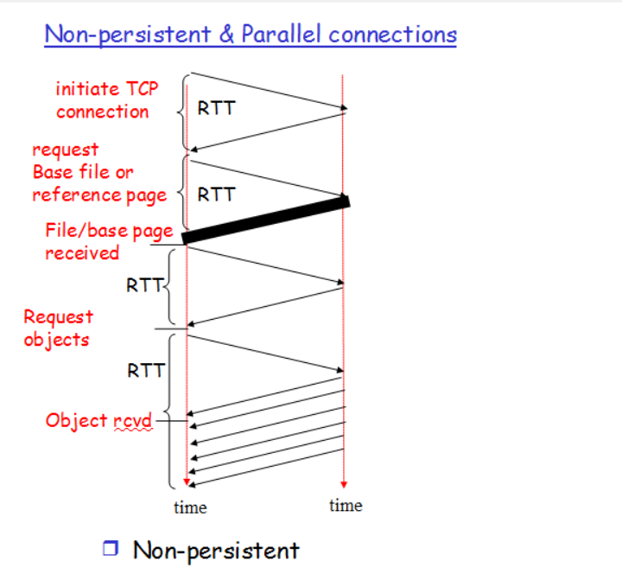
2: Application Layer
25

Slide 26
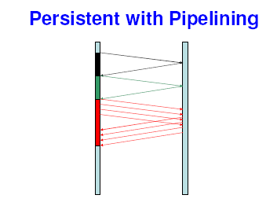
2: Application Layer
26

Slide 27
Nonpersistent HTTP issues:
requires 2 RTTs per object
OS overhead for each TCP connection
browsers often open parallel TCP connections to fetch referenced objects
Persistent HTTP
server leaves connection open after sending response
subsequent HTTP messages between same client/server sent over open connection
client sends requests as soon as it encounters a referenced object
as little as one RTT for all the referenced objects
* With Pipelining and without pipelining
27

Slide 28
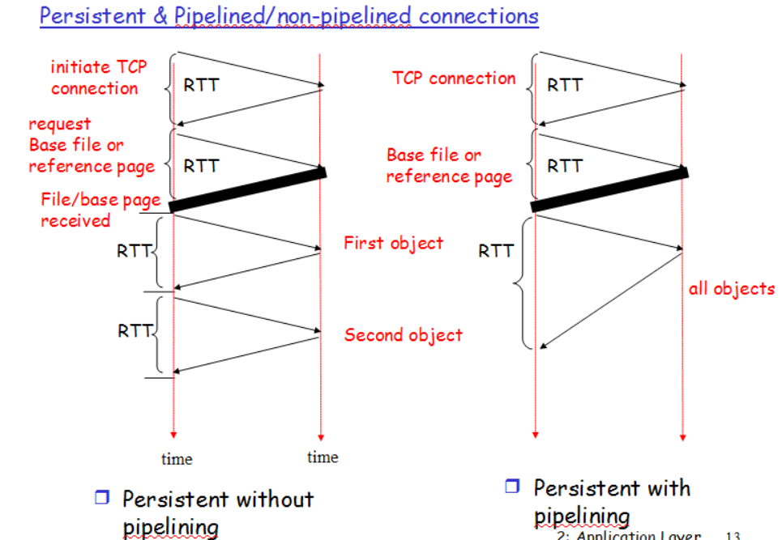
2: Application Layer
28

Slide 29
HTTP request message
two types of HTTP messages: request, response
HTTP request message:
ASCII (human-readable format)
request line
(GET, POST,
HEAD commands)
GET /somedir/page.html HTTP/1.1
Host: www.someschool.edu
User-agent: Mozilla/4.0
Connection: close
Accept-language:fr
(extra carriage return, line feed)
header
lines
Carriage return,
line feed
indicates end
of message
29
Notes:
https://www.w3schools.com/tags/ref_httpmethods.asp
29

Slide 30
HTTP request Method types
HTTP/1.0
1. GET
2. POST
3. HEAD
HTTP/1.1
GET, POST, HEAD
PUT
uploads an object used in conjunction with web publishing tools.
uploads an object to a specific path (directory)in URL field on a specific web server.
DELETE
deletes file specified in the URL field
30

Slide 31
HTTP request Header field lines
These fields are used to pass additional information about the
request or about the client or to add conditions to the request.
Common HTTP request headers:-
1.Host
2. Content Length
3. Content-type
4. Authentication
5. Use Agent
6. Accept language
8. Cookie
31

Slide 32
HTTP response message
status line
(protocol
status code
status phrase)
HTTP/1.1 200 OK
Connection close
Date: Thu, 06 Aug 1998 12:00:15 GMT
Server: Apache/1.3.0 (Unix)
Last-Modified: Mon, 22 Jun 1998 …...
Content-Length: 6821
Content-Type: text/html
data data data data data ...
header
lines
data, e.g.,
requested
HTML file
2: Application Layer
32

Slide 33
HTTP response status codes
1xx :- indicates informational message only
2xx :- indicates that all is well with the request
3xx :- indicates some form of redirection i.e.
redirects the client to another URL
4xx :- indicates an error and server is blaming the
browser for doing something wrong
5xx :- indicates an error on the servers part.
33

Slide 34
HTTP response status codes
In first line in server->client response message.
A few sample codes:
200 OK
request succeeded, response is included in the content
200 No response
request succeeded, but no response is provided.
301 Moved Permanently
Indicates that URL of the requested resource has changed.
302 Found
It functions like 301 response except that the move is temporary
303 see other
It indicates that the resource has temporarily moved and it is obtained from new URL via GET request only.
34

Slide 35
400 Bad Request
request message not understood by server due to bad syntax
401 Unauthorized
Indicates that the requested resource is in a protected medium.
403 Forbidden
Indicates that client is not allowed to access the requested resource for some reasons, other than valid HTTP login.
404 Not Found
requested document not found on this server
408 Request time out
35

Slide 36
500 Internal server error
Indicates that something happened on the server that caused the transaction to fail.
503 Service unavailable
Indicates that the server is unable to respond to the request due to a high volume of traffic
505 HTTP Version Not Supported
36

Slide 37
HTTP response server Headers
Content length
Content type
Date
Last Modified
Location
Server
Set cookie
37

Slide 38
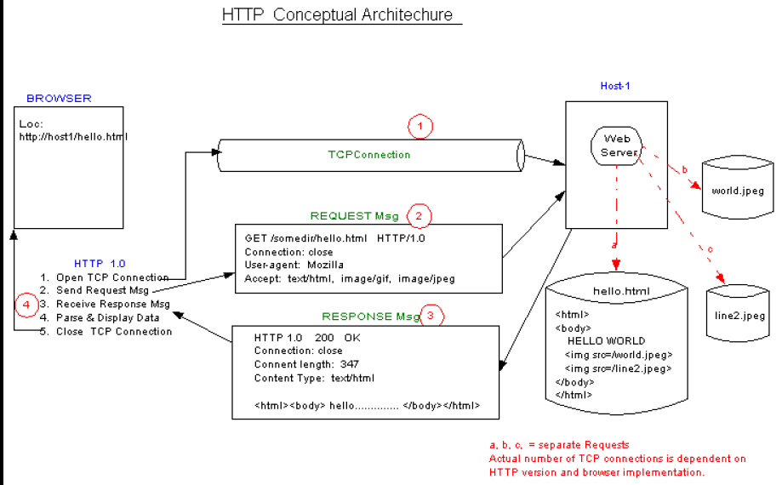
2: Application Layer
38

Slide 39
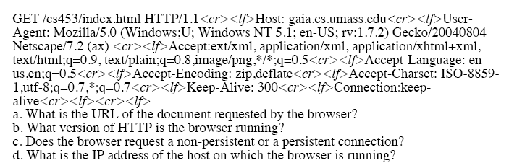
Ques:
2: Application Layer
39
Notes:
39

Slide 40
Answers
The URL of the document is cs453/index.html.
The browser is running version 1.1 of HTTP.
The browser requests a persistent connection. This is shown by the line “Connection:keep-alive.”
The IP address of the host on which the browser is running is gaia.cs.umass.edu.
2: Application Layer
40
Notes:
https://smartedblog.wordpress.com/2013/02/22/networking-homework-3/
40

Slide 41
User-server state: cookies
Example:
Susan always access Internet always from PC
visits specific e-commerce site for first time
when initial HTTP requests arrives at site, site creates:
unique ID
entry in backend database for ID
Many major Web sites use cookies
Four components:
1) cookie header line of HTTP response message
2) cookie header line in HTTP request message
3) cookie file kept on user’s host, managed by user’s browser
4) back-end database at Web site
41

Slide 42
Cookies: keeping “state” (cont.)
client
server
ebay 8734
usual http request msg
Amazon server
creates ID
1678 for user
cookie file
usual http response
Set-cookie: 1678
create
entry
ebay 8734
amazon 1678
usual http request msg
cookie: 1678
cookie-
specific
action
access
one week later:
usual http response msg
backend
database
access
ebay 8734
amazon 1678
usual http request msg
cookie: 1678
cookie-
spectific
action
usual http response msg
42

Slide 43
Cookies (continued)
aside
What cookies can bring:
authorization
shopping carts
recommendations
user session state (Web e-mail)
Cookies and privacy:
cookies permit sites to learn a lot about you
you may supply name and e-mail to sites
How to keep “state”:
protocol endpoints: maintain state at sender/receiver over multiple transactions
cookies: http messages carry state
43

Slide 44



Web caches (proxy server)
Goal: satisfy client request without involving origin server
user sets browser: Web accesses via cache
browser sends all HTTP requests to cache
object in cache: cache returns object
else cache requests object from origin server, then returns object to client
origin
server
Proxy
server
HTTP request
HTTP request
client
HTTP response
HTTP response
HTTP request
HTTP response
client
origin
server
44

Slide 45
More about Web caching
cache acts as both client and server
typically cache is installed by ISP (university, company, residential ISP)
Why Web caching?
reduce response time for client request
reduce traffic on an institution’s access link.
Internet dense with caches: enables “poor” content providers to effectively deliver content (but so does P2P file sharing)
45

Slide 46
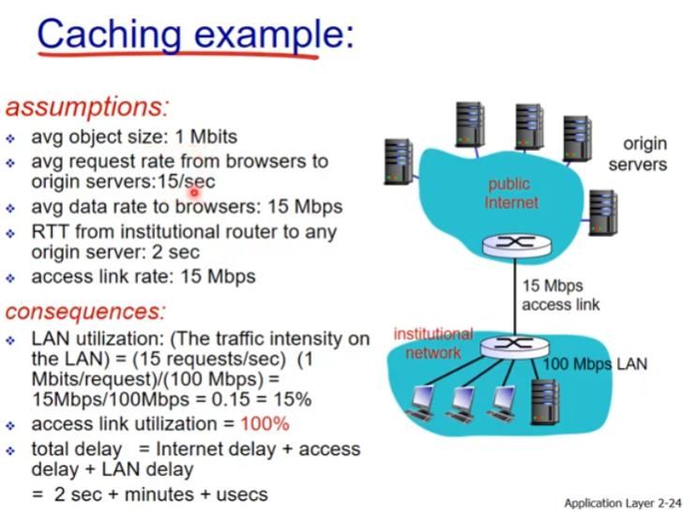

Slide 47
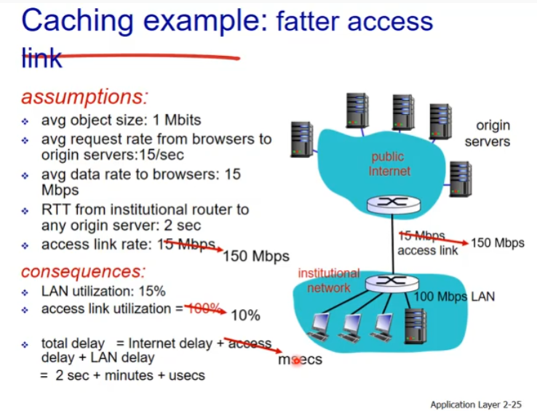

Slide 48
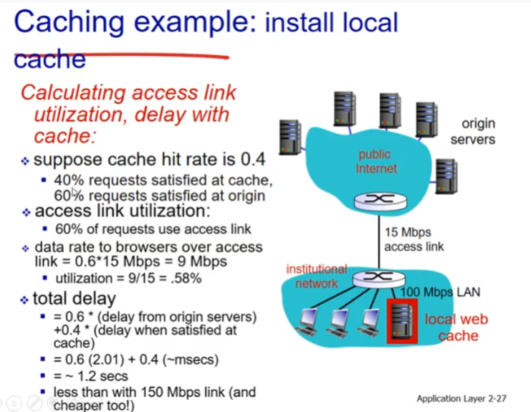

Slide 49
Practice yourself: Caching example
origin
servers
Assumptions
average object size = 1Mbits
avg. request rate from institution’s browsers to origin servers = 15/sec
delay from institutional router to any origin server and back to router = 2 sec
Consequences
utilization on LAN = 15%
utilization on access link = 100%
total delay = Internet delay + access delay + LAN delay
= 2 sec + minutes + milliseconds
public
Internet
1.5 Mbps
access link
institutional
network
10 Mbps LAN
institutional
cache
49

Slide 50
Practice yourself :Caching example (cont)
origin
servers
possible solution
increase bandwidth of access link to, say, 10 Mbps
consequence
utilization on LAN = 15%
utilization on access link = 15%
Total delay = Internet delay + access delay + LAN delay
= 2 sec + msecs + msecs
often a costly upgrade
public
Internet
10 Mbps
access link
institutional
network
10 Mbps LAN
institutional
cache
50

Slide 51
Practice yourself : Caching example (cont)
origin
servers
possible solution: install cache
suppose hit rate is 0.4
consequence
40% requests will be satisfied almost immediately
60% requests satisfied by origin server
utilization of access link reduced to 60%, resulting in negligible delays (say 10 msec)
total avg delay = Internet delay + access delay + LAN delay = .6*(2.01) secs + .4*milliseconds < 1.4 secs
public
Internet
1.5 Mbps
access link
institutional
network
10 Mbps LAN
institutional
cache
51

Slide 52
DNS: Domain Name System
People: many identifiers:
SSN, name, passport #
Internet hosts, routers:
IP address (32 bit) - used for addressing datagrams
“name”, e.g., ww.yahoo.com - used by humans
Q: map between IP addresses and name ?
Domain Name System:
distributed database implemented in hierarchy of many name servers
application-layer protocol host, routers, name servers to communicate to resolve names (address/name translation)
note: core Internet function, implemented as application-layer protocol
complexity at network’s “edge”

Slide 53
DNS
DNS services
Hostname to IP address translation
Host aliasing
Canonical and alias names
Mail server aliasing
Load distribution
Replicated Web servers: set of IP addresses for one canonical name
Why not centralize DNS?
single point of failure
traffic volume
distant centralized database
maintenance
doesn’t scale!

Slide 54
Services provided by DNS
Example: Consider what happens when a browser (that is an http client) running on some user’s host, requests the URL www.someschool.edu/index.html.
In order for the user’s host to be able to send an HTTP request message to the web server www.someschool.edu, the user’s host must first obtain the ip address of www.someschool.edu. This is done in following fashion:
The same user machine runs the client side of the DNS application.
The browser extracts the hostname www.someschool.edu. from the url and passes the hostname to the client side of the DNS application.
The DNS client sends a query containing the hostname to a DNS server.
The DNS client eventually receives a reply, which includes the ip address for the hostname.
Once the browser receives the ip address from DNS, it can initiate a TCP connection to the HTTP server process located at port 80 at that ip address.

Slide 55
Distributed, Hierarchical Database
Root DNS Servers
com DNS servers
org DNS servers
edu DNS servers
yahoo.com
DNS servers
pbs.org
DNS servers
poly.edu
DNS servers
umass.edu
DNS servers
amazon.com
DNS servers
Client wants IP for www.amazon.com; 1st approx:
Client queries a root server to find com DNS server
Client queries com DNS server to get amazon.com DNS server
Client queries amazon.com DNS server to get IP address for www.amazon.com

Slide 56
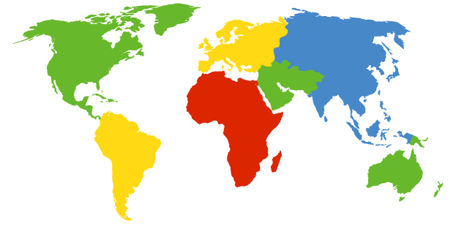
DNS: Root name servers
In the internet there are 13 root DNS servers, most of which are located in North America.
Each server is actually a cluster of replicated servers, for both security and reliability purposes.
contacted by local name server that can not resolve name
root name server:
contacts authoritative name server if name mapping not known
gets mapping
returns mapping to local name server
a Verisign, Dulles, VA
c Cogent, Herndon, VA (also Los Angeles)
d U Maryland College Park, MD
g US DoD Vienna, VA
h ARL Aberdeen, MD
j Verisign, ( 11 locations)
k RIPE London (also Amsterdam, Frankfurt)
i Autonomica, Stockholm (plus 3 other locations)
m WIDE Tokyo
e NASA Mt View, CA
f Internet Software C. Palo Alto, CA (and 17 other locations)
13 root name servers worldwide
b USC-ISI Marina del Rey, CA
l ICANN Los Angeles, CA

Slide 57
TLD and Authoritative Servers
Top-level domain (TLD) servers: responsible for com, org, net, edu, etc, and all top-level country domains uk, fr, ca, jp.
Network solutions maintains servers for com TLD
Educause for edu TLD
Authoritative DNS servers: organization’s DNS servers, providing authoritative hostname to IP mappings for organization’s servers (e.g., Web and mail).
Can be maintained by organization or service provider

Slide 58
Local Name Server
Does not strictly belong to hierarchy
Each ISP (residential ISP, company, university) has one.
Also called “default name server”
When a host makes a DNS query, query is sent to its local DNS server
Acts as a proxy, forwards query into hierarchy.

Slide 59
Example
root DNS server
Host at cis.poly.edu wants IP address for gaia.cs.umass.edu.
Suppose that Polytechnic’s local DNS server is dns.poly.edu and that an authoritative DNS server for gaia.cs.umass.edu is called dns.cs.umass.edu.
Step1: the host cis.poly.edu first sends a DNS query message to its local DNS server, dns.poly.edu. This query message contains the hostname to be translated , namely, gaia.cs.umass.edu.
Step 2: The local DNS server forwards the query message to a root DNS server. The root DNS server take a note of the edu suffix and returns to the local DNS server a list of IP addresses for TLD servers responsible for edu.
Step 3: The local DNS server then resends the query message to one of these TLD servers. The TLD server take a note of umass.edu suffix and responds with the ip address of authoritative DNs server for the dns.umass.edu
Step 4: Finally the local DNS server resends the query message directly to dns.umass.edu which responds with the ip address of gais.cs.umass.edu
Iterative
2
3
TLD DNS server
4
Iterative
5
local DNS server
dns.poly.edu
Iterative
7
6
1
8
Recursive
authoritative DNS server
Dns.cs.umass.edu
requesting host
cis.poly.edu
gaia.cs.umass.edu

Slide 60
Recursive queries
root DNS server
recursive query:
puts burden of name resolution on contacted name server
heavy load?
iterated query:
contacted server replies with name of server to contact
“I don’t know this name, but ask this server”
Recursive
2
3
Recursive
7
6
TLD DNS server
local DNS server
dns.poly.edu
Recursive
5
4
1
8
Recursive
authoritative DNS server
dns.cs.umass.edu
requesting host
cis.poly.edu
gaia.cs.umass.edu

Slide 61
DNS: caching and updating records
once (any) name server learns mapping, it caches mapping
cache entries timeout (disappear) after some time
TLD servers typically cached in local name servers
Thus root name servers not often visited
update/notify mechanisms under design by IETF
RFC 2136
http://www.ietf.org/html.charters/dnsind-charter.html

Slide 62
DNS records
DNS: distributed db storing resource records (RR)
RR format: (name, value, type, ttl)
Type=A
name is hostname
value is IP address
Type=CNAME
name is alias name for some “canonical” (the real) name
www.ibm.com is really
servereast.backup2.ibm.com
value is canonical name
Type=NS
name is domain (e.g. foo.com)
value is hostname of authoritative name server for this domain
Type=MX
value is name of mailserver associated with name

Slide 63
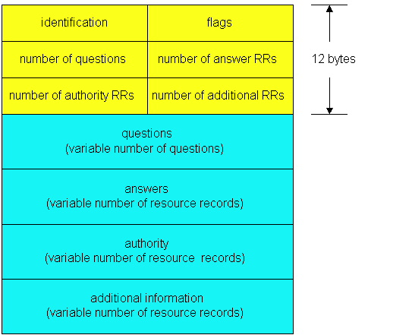
DNS protocol, messages
DNS protocol : query and reply messages, both with same message format
msg header
identification: 16 bit # for query, reply to query uses same #
flags:
query or reply
recursion desired
recursion available
reply is authoritative

Slide 64
DNS protocol, messages
Name, type fields
for a query
RRs in response
to query
records for
authoritative servers
additional “helpful”
info that may be used

Slide 65
FTP
65

Slide 66

FTP: the file transfer protocol
FTP
user
interface
FTP
client
file transfer
FTP
server
user
at host
remote file
system
local file
system
transfer file to/from remote host
client/server model
client: side that initiates transfer (either to/from remote)
server: remote host
ftp server: port 21
66

Slide 67
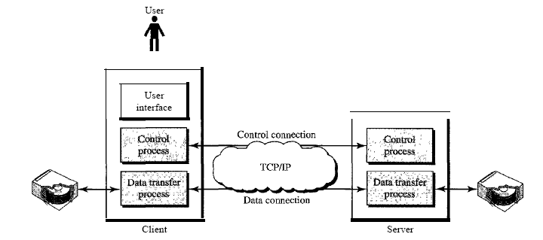
2: Application Layer
67

Slide 68
FTP: separate control, data connections
TCP control connection
port 21
FTP client contacts FTP server at port 21, TCP is transport protocol
client authorized over control connection
client browses remote directory by sending commands over control connection.
when server receives file transfer command, server opens 2nd TCP connection (for file) to client
after transferring one file, server closes data connection.
FTP
client
TCP data connection
port 20
FTP
server
server opens another TCP data connection to transfer another file.(data connections are non persistent)
control connection: “out of band”
FTP server maintains “state”: current directory, earlier authentication
68

Slide 69
In active mode, the client establishes the command channel (from client port X to server port 21) but the server establishes the data channel (from server port 20 to client port Y, where Y has been supplied by the client).
In passive mode, the client establishes both channels. In that case, the server tells the client which port should be used for the data channel.
2: Application Layer
69

Slide 70
FTP commands, responses
Sample commands:
sent as ASCII text over control channel
USER username
PASS password
LIST return list of file in current directory
RETR filename retrieves (gets) file
STOR filename stores (puts) file onto remote host
Sample return codes
status code and phrase (as in HTTP)
331 Username OK, password required
125 data connection already open; transfer starting
425 Can’t open data connection
452 Error writing file
70

Slide 71
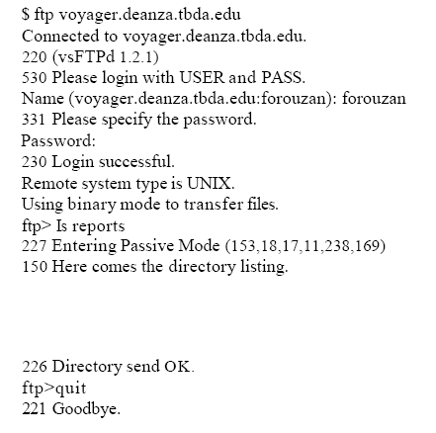
71

Slide 72
FTP server listens for connection on port number a) 20 b) 21 c) 22 d) 23
In FTP protocol, client contacts server using ____ as the transport protocol. a) transmission control protocol b) user datagram protocol c) datagram congestion control protocol d) stream control transmission protocol
In which mode FTP, the client initiates both the control and data connections. a) active mode b) passive mode c) both (a) and (b) d) none of the mentioned
72

Slide 73
Electronic Mail
SMTP, POP3, IMAP
73

Slide 74
Electronic Mail
outgoing
message queue
user mailbox
Three major components:
user agents
mail servers
simple mail transfer protocol: SMTP
User Agent
a.k.a. “mail reader”
composing, editing, reading mail messages
e.g., Eudora, Outlook, elm, Mozilla Thunderbird
outgoing, incoming messages stored on server
user
agent
mail
server
user
agent
SMTP
mail
server
user
agent
SMTP
SMTP
mail
server
user
agent
user
agent
user
agent
74

Slide 75
Electronic Mail: mail servers
Mail Servers
mailbox contains incoming messages for user
message queue of outgoing (to be sent) mail messages
SMTP protocol between mail servers to send email messages
client: sending mail server
“server”: receiving mail server
user
agent
mail
server
user
agent
SMTP
mail
server
user
agent
SMTP
SMTP
mail
server
user
agent
user
agent
user
agent
75

Slide 76
Electronic Mail: SMTP
uses TCP to reliably transfer email message from client to server, port 25
direct transfer: sending server to receiving server
three phases of transfer
handshaking (greeting)
transfer of messages
closure
command/response interaction
commands: ASCII text
response: status code and phrase
messages must be in 7-bit ASCII
76

Slide 77

Scenario: Alice sends message to Bob
1) Alice uses UA to compose message and “to” bob@someschool.edu
2) Alice’s UA sends message to her mail server; message placed in message queue
3) Client side of SMTP opens TCP connection with Bob’s mail server
4) SMTP client sends Alice’s message over the TCP connection
5) Bob’s mail server places the message in Bob’s mailbox
6) Bob invokes his user agent to read message
1
mail
server
mail
server
user
agent
user
agent
2
3
6
4
5
77

Slide 78
Sample SMTP interaction
S: 220 hamburger.edu
C: HELO crepes.fr
S: 250 Hello crepes.fr, pleased to meet you
C: MAIL FROM: <alice@crepes.fr>
S: 250 alice@crepes.fr... Sender ok
C: RCPT TO: <bob@hamburger.edu>
S: 250 bob@hamburger.edu ... Recipient ok
C: DATA
S: 354 Enter mail, end with "." on a line by itself
C: Do you like ketchup?
C: How about pickles?
C: .
S: 250 Message accepted for delivery
C: QUIT
S: 221 hamburger.edu closing connection
78

Slide 79
SMTP: final words
SMTP uses persistent connections
SMTP requires message (header & body) to be in 7-bit ASCII
SMTP server uses CRLF.CRLF to determine end of message
Comparison with HTTP:
HTTP: pull
SMTP: push
both have ASCII command/response interaction, status codes
HTTP: each object encapsulated in its own response msg
SMTP: multiple objects sent in multipart msg
79

Slide 80
Mail message format
SMTP: protocol for exchanging email msgs
RFC 822: standard for text message format:
header lines, e.g.,
To:
From:
Subject:
different from SMTP commands!
body
the “message”, ASCII characters only
header
blank
line
body
80

Slide 81
Message format: multimedia extensions
MIME: multimedia mail extension, RFC 2045, 2056
additional lines in msg header declare MIME content type
From: alice@crepes.fr
To: bob@hamburger.edu
Subject: Picture of yummy crepe.
MIME-Version: 1.0
Content-Transfer-Encoding: base64
Content-Type: image/jpeg
base64 encoded data .....
.........................
......base64 encoded data
MIME version
method used
to encode data
multimedia data
type, subtype,
parameter declaration
encoded data
81

Slide 82
Mail access protocols
SMTP
SMTP
access
protocol
user
agent
user
agent
sender’s mail
server
receiver’s mail
server
SMTP: delivery/storage to receiver’s server
Mail access protocol: retrieval from server
POP: Post Office Protocol [RFC 1939]
authorization (agent <-->server) and download
IMAP: Internet Mail Access Protocol [RFC 1730]
more features (more complex)
manipulation of stored msgs on server
HTTP: gmail, Hotmail, Yahoo! Mail, etc.
82

Slide 83
POP3 protocol[110 port]
S: +OK POP3 server ready
C: user bob
S: +OK
C: pass hungry
S: +OK user successfully logged on
authorization phase
client commands:
user: declare username
pass: password
server responses
+OK
-ERR
transaction phase, client:
list: list message numbers
retr: retrieve message by number
dele: delete
quit
C: list
S: 1 498
S: 2 912
S: .
C: retr 1
S: <message 1 contents>
S: .
C: dele 1
C: retr 2
S: <message 1 contents>
S: .
C: dele 2
C: quit
S: +OK POP3 server signing off
83

Slide 84
POP3 (more) and IMAP
More about POP3
Two Modes of POP3
1. “download and delete” mode.
2. “Download-and-keep”: copies of messages on different clients
POP3 is stateless across
sessions
IMAP
Keep all messages in one place: the server
Allows user to organize messages in folders
IMAP keeps user state across sessions:
names of folders and mappings between message IDs and folder name
84

